Slide 1
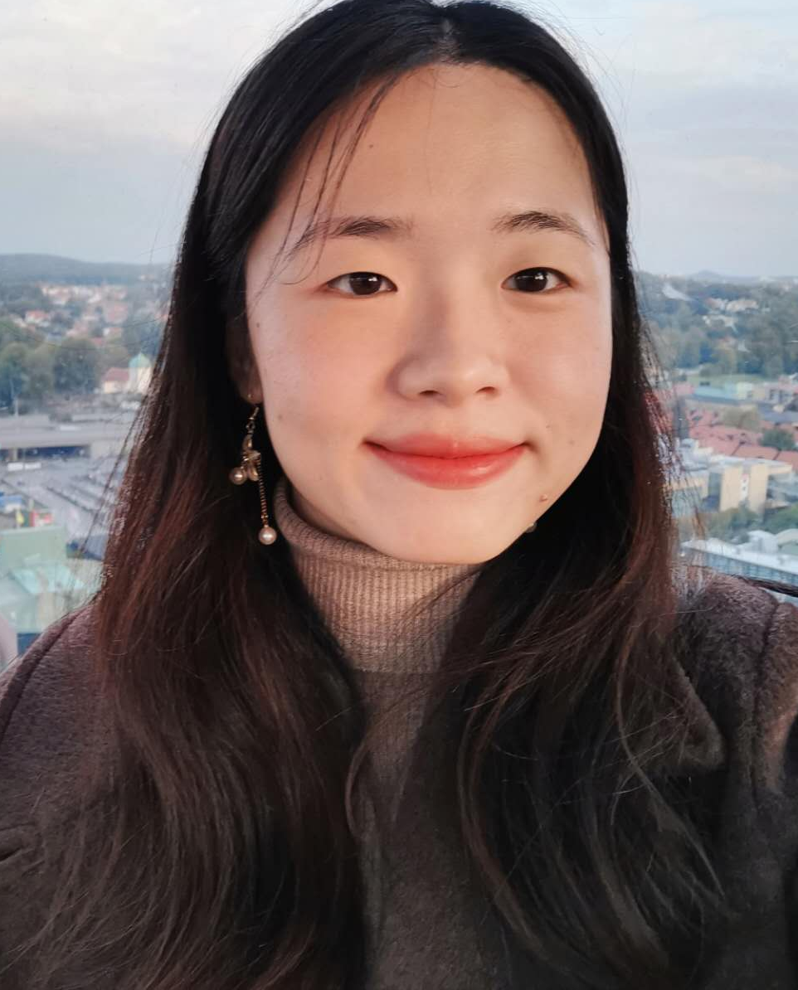
Xingrong Zong – Personal Letter
Software Technology
I am writing to express my strong interest in the xxxxx position at xxxxx. As a highly motivated and results-driven individual, I believe that my attention to detail and ability to work well under pressure make me a strong candidate for this position.
I am currently enrolled in the "Frontendutvecklare Inriktning Webbsäkerhet" program at Jensen Yrkeshögskolan to further enhance my programming skills and expand my competence in this area.
I am looking for a company that provides a global work environment where I can leverage my language and communication strengths to the fullest. If given the opportunity to join xxxxx, I am confident that my quick learning ability and background in computer science would enable me to quickly integrate into your team and I will work hard towards the objectives and goals of your team.
Thank you for considering my application. I am eager to join xxxxx and look forward to the opportunity to discuss my qualifications with you in person.
Sincerely,
Xingrong Zong
25/10/2023
ronazong.work@gmail.com
linkedin.com/in/ronazong
github.com/RonaZong
0761-66 52 46
Ebbe Lieberathsgatan 33B
41265 Gothenburg

Slide 2
Xingrong Zong – Personal Letter
Software Technology
I am writing to express my strong interest in the Internship position at Plejd. As a highly motivated and results-driven individual, I believe that my attention to detail and ability to work well under pressure make me a strong candidate for this position.
I am currently enrolled in the "Frontendutvecklare Inriktning Webbsäkerhet" program at Jensen Yrkeshögskolan to further enhance my programming skills and expand my competence in this area.
I am looking for a company that provides a global work environment where I can leverage my language and communication strengths to the fullest. If given the opportunity to join Plejd, I am confident that my quick learning ability and background in computer science would enable me to quickly integrate into your team and I will work hard towards the objectives and goals of your team.
Thank you for considering my application. I am eager to join Plejd and look forward to the opportunity to discuss my qualifications with you in person.
Sincerely,
Xingrong Zong
02/11/2023
ronazong.work@gmail.com
linkedin.com/in/ronazong
github.com/RonaZong
0761-66 52 46
Ebbe Lieberathsgatan 33B
41265 Gothenburg

Slide 3
Xingrong Zong – Personal Letter
Software Technology
I am writing to express my strong interest in the IT Service Technician or an intern position at Yara Marine. As a highly motivated and results-driven individual, I believe that my attention to detail and ability to work well under pressure make me a strong candidate for this position.
I am currently enrolled in the "Frontendutvecklare Inriktning Webbsäkerhet" program at Jensen Yrkeshögskolan to further enhance my programming skills and expand my competence in this area.
I am looking for a company that provides a global work environment where I can leverage my language and communication strengths to the fullest. If given the opportunity to join Yara Marine, I am confident that my quick learning ability and background in computer science would enable me to quickly integrate into your team and I will work hard towards the objectives and goals of your team.
Thank you for considering my application. I am eager to join Yara Marine and look forward to the opportunity to discuss my qualifications with you in person.
Sincerely,
Xingrong Zong
25/10/2023
ronazong.work@gmail.com
linkedin.com/in/ronazong
github.com/RonaZong
0761-66 52 46
Ebbe Lieberathsgatan 33B
41265 Gothenburg

Slide 4
Xingrong Zong – Personal Letter
Software Technology
I am writing to express my strong interest in the Software Application Engineer or an intern position at Yara Marine. As a highly motivated and results-driven individual, I believe that my attention to detail and ability to work well under pressure make me a strong candidate for this position.
I am currently enrolled in the "Frontendutvecklare Inriktning Webbsäkerhet" program at Jensen Yrkeshögskolan to further enhance my programming skills and expand my competence in this area.
I am looking for a company that provides a global work environment where I can leverage my language and communication strengths to the fullest. If given the opportunity to join Yara Marine, I am confident that my quick learning ability and background in computer science would enable me to quickly integrate into your team and I will work hard towards the objectives and goals of your team.
Thank you for considering my application. I am eager to join Yara Marine and look forward to the opportunity to discuss my qualifications with you in person.
Sincerely,
Xingrong Zong
25/10/2023
ronazong.work@gmail.com
linkedin.com/in/ronazong
github.com/RonaZong
0761-66 52 46
Ebbe Lieberathsgatan 33B
41265 Gothenburg

